Slide 1
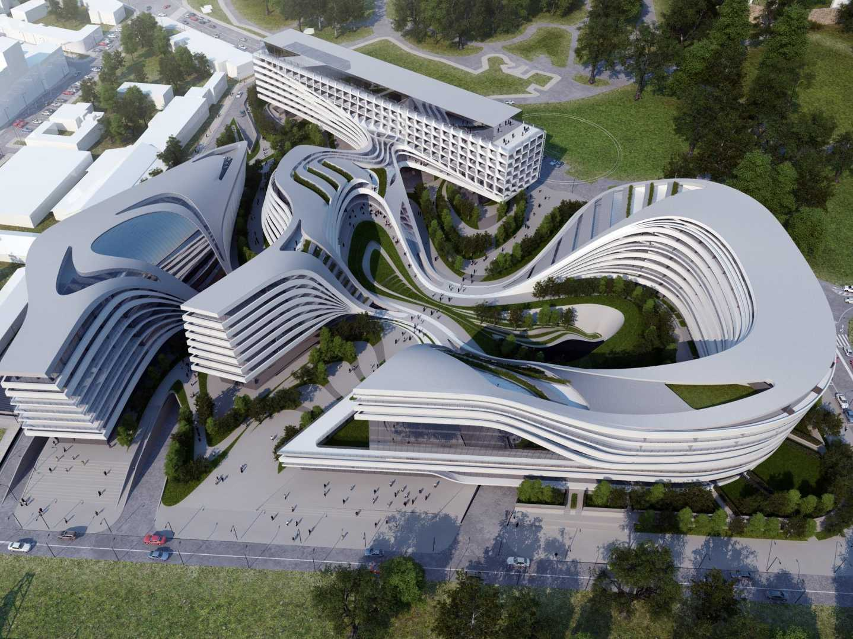
Data Virtualization
PDTool Training Template
Presenter
Title

Slide 2
Agenda
Topic 1
Topic 2
Topic 3

Slide 3
Topic 1
© Copyright 2000-2017 TIBCO Software Inc.
Notes:
Next, let’s examine some common deployment options for CIS.

Slide 4
Topic Sub-Topic
Text 1 – x
Bullet 1
Bullet 2.
Text 2 – x
Bullet 1.
Text 3 – x
Bullet 1.
© Copyright 2000-2017 TIBCO Software Inc.

Slide 5
Course Labs
Installation
Connect to CSV File
Creating a Simple View
Creating Joins and using the Grid Panel
Publishing Views as a Database
Publishing Views as a Web Service
Procedures: SQL Script
Procedures: Parameterized Queries
Procedures: Packaged Queries
© Copyright 2000-2017 TIBCO Software Inc.
Notes:
Next, let’s examine some common deployment options for CIS.

Slide 6










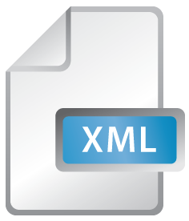




Relational
Data Warehouse
Packaged App
Big Data
Hierarchal
HTML
Web Services
Word
Excel
HTML
XML
File
Flat File
Tablet
Smart Phone

Slide 7


















BI Tools
Excel
Web Portal
Enterprise Search
Relational Views
Spreadsheet
Virtual Mart/ODS
Cache
Services

